Slide 1

OGSA HPC cluster usecase for reference Model v.02
OGSA reference model design team
Hiro Kishimoto
Oct. 22, 2006

Slide 2

OGSA HPC cluster
Computing Node × 16
Management Network
100Mbps
Data Network
2.5Gbps
HPC cluster is set of computational servers connected high-speed network
  It is not grid in general sense
Administrator deploy multiple applications on computing nodes
Users submit computational jobs to cluster (management host)
  Each job runs on one or more computing nodes exclusively
  More than one job can run on each node in turns
EPS (scheduler) prioritize submitted jobs based on administers policy
EPS monitors and logs note usage for accounting and billing
Ethernet HUB
InfiniBandTM Switch
Management Host
To external Network

Slide 3
Workload
Non interactive batch workload
User may submit multiple jobs
  E.g. workload consists of 100 jobs
  Each job last several seconds to several days
  Single job (run on single node) or parallel job (run on multiple nodes)
Each job is “abstract application”: top level entity of Grid Component tree diagram
  Job is different form “transactions” of online shopping application

Slide 4
Batch job: grid component mapping
V02: Add BLAST binary and CHARMM binary
Abstract
Application
Definition
Paul’s
BLAST
Hiro’s
BLAST
Andrew’s
BLAST
Paul’s
CHARMM
Hiro’s
CHARMM
Virtualized
Operating
Environment
HPC
Cluster
BLAST
binary
CHARMM
binary
Physical
Mgmt
server
Comp
node
Each node is shared by multiple jobs, even though job runs exclusively

Slide 5
OGSA HPC usecase diagram
Provision node
EGA reference model defines these usecases
EGA reference model defines these usecases
HPC profile, JSDL, and BES only covers here
Provision OS
Provision server pool
Deploy Application
Submit Job
Manage job
User
Undeploy application
Administrator
Decommission server pool
Decommission OS
Decommission node
HPC cluster

Slide 6
Manage Job for enterprise apps
Review the Reference Model 'Manage Job' in more detail. Specifically look at it from the perspective of an enterprise application (e.g., a 3-tier app)
Start
Stop
Resume
Get Status
…

Slide 7
Reference model’s general life cycle
Unconfigured
Create
Destroy
Configure
Unconfigure
Inactive
Start
Stop
Active

Slide 8
BES’s basic state model
Canceled
TerminateActivity request
Successful termination of activity
Pending
Running
Finished
System error/failure event
Failed

Slide 9
OGSA HPC job status
V02: Separate job and binary
Pending
Finished
??
CreateActivity
?? (allocate)
??
??
??
?? (successful
termination)
running

Slide 10
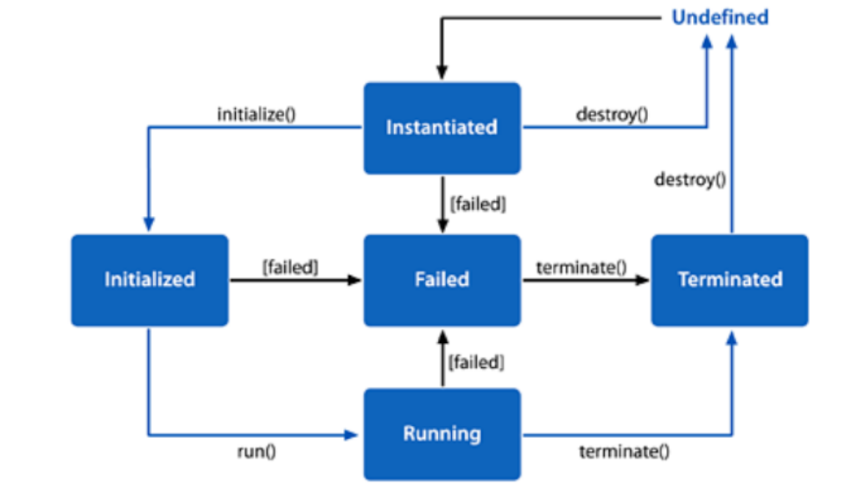
CDDLM component Lifecycle Model

Slide 11
OGSA HPC binary status
V02: Separate job and binary
Instantiated
terminated
Create
Destroy
Initialize
terminate
??
??
??
Initialized
Application binary does
not have “running” state.

Slide 12
Full Copyright Notice
Copyright (C) Open Grid Forum (2006). All Rights Reserved.
This document and translations of it may be copied and furnished to others, and derivative works that comment on or otherwise explain it or assist in its implementation may be prepared, copied, published and distributed, in whole or in part, without restriction of any kind, provided that the above copyright notice and this paragraph are included on all such copies and derivative works.
The limited permissions granted above are perpetual and will not be revoked by the OGF or its successors or assignees.
Notes:
OGF Full Copyright Notice if necessary

